Slide 1
CST 250 Microcomputer Architecture and Programming
Dr. Sohum Sohoni

Slide 2
Who Am I?
Sohum Sohoni, Assistant Professor
PhD University of Cincinnati
BS Pune University, India
230H Peralta, sohum.sohoni@asu.edu
Office hours: Tuesday, Thursday 3PM to 4 PM and by appointment

Slide 3
CST 250 Objectives 1
Trace the execution of an instruction through the CPU’s datapath
A peek at how things are organized in a processor
Show how numbers and program statements are stored and operated on by the CPU
When you write and compile a program, what happens to it?
How does the computer distinguish between 12.5 and the word bicycle if everything is stored as a sequence of zeroes and ones?

Slide 4
CST 250 Objectives 2
Generate original assembly code using the software development cycle
Analyze problem, create algorithm, draw flowchart, write program, and debug program
Interfacing with peripheral I/O
How can I make it work with other devices?
Collaboration
How do I apply my knowledge in a problem-based team setting and learn from that?
Create and deliver technical presentations

Slide 5
Syllabus
On blackboard
Let’s take a look
Grades will be updated here regularly

Slide 6
Teaching Style 1
I believe that you are here to learn, not just to get through the course with some grade
But, grades are important!
Learn by doing
Learning occurs in lab, lectures will facilitate success in lab
The more you do, the more you learn
Learning beyond CST250: lifelong learning
You will be asked to reflect on what you learned this week, this semester
Do that in your other courses too, and in life

Slide 7
Teaching Style 2
Labs on Thursdays
Hybrid flipped class
Watch tutorials, read slides before coming to class
Class and lab will be active
Not boring!

Slide 8
Some Advice
Don’t panic!
Try at least a couple of different things before asking for help
Do ask for help
My goal is to ask questions and let you figure out the solution
This may be frustrating, but it is worth it
If you don’t understand what I am saying, please let me know
First lab is individual, some lab assignments will be done in pairs, some in teams

Slide 9
Bonus Points Assignment 1
2-slide Introduction
My example on blackboard
Due on August 28th, noon.

Slide 10
Instruction Set
The repertoire of instructions of a computer
Different computers have different instruction sets
But with many aspects in common
Example Add, Subtract
PLP Instruction Set available at:
http://progressive-learning-platform.googlecode.com/hg/misc/quick_reference.pdf
Before we get into the details, let us consider why every computer has an instruction set
Any guesses?

Slide 11
Instruction Set cont.
Contract between hardware and software
A map of what the processors is capable of doing
Translates to zeroes and ones, but is more human readable
Is how software communicates with hardware to make things happen

Slide 12
Example
C code:
f = (g + h) - (i + j);
PLP code:
add $t0, $s1, $s2 add $t1, $s3, $s4 sub $s0, $t0, $t1
Assumes that g through j are in registers
So, what are registers, and how did our variables get there?

Slide 13
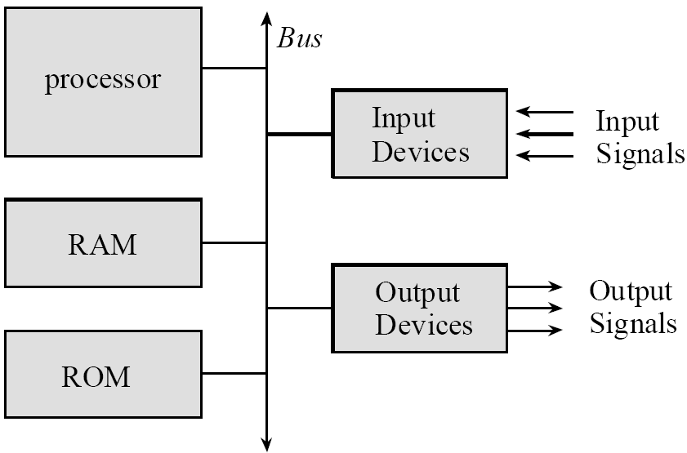
Big Picture

Slide 14
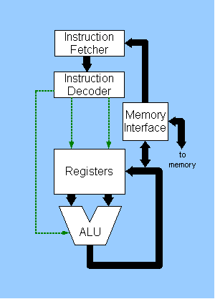
Block Diagram of CPU
Image from Wikimedia
http://commons.wikimedia.org/wiki/File:CPU_block_diagram.png

Slide 15
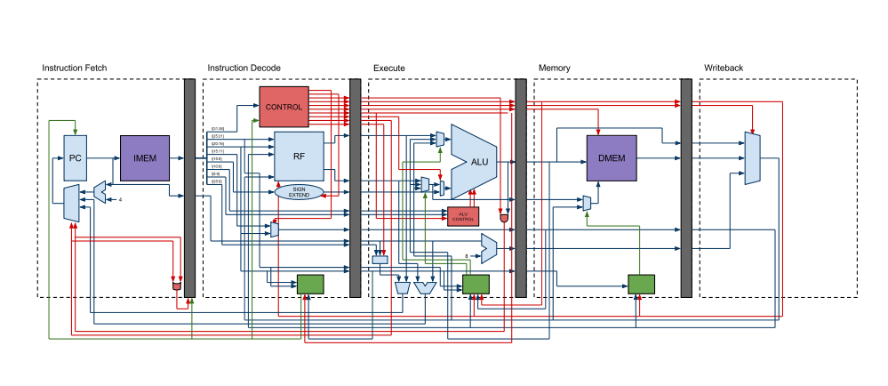
PLP CPU Diagram

Slide 16
CPU Registers
Fast, temporary storage for variables
MIPS and PLP have instruction sets that operate mostly using registers
i.e. no direct manipulation of memory
Cannot say f = g+h directly
Have to get g and h into registers first- how?

